Slide 1

Stars….. Stars are formed form giant clouds of dust and gas in THE EAGLE NEBULA.
Astronomical object consisting of a luminous spheroid of plasma held together by its own gravity..
Self luminous celestial body..
Classification of stars…..
1. Young star is called DWARF star. It can be a yellow star, white star or a red star.
2. Old star are called as called as SUPERGIANTS star. They are blue or red.
Stars are classified according to their temperature and brightness into 2 categories
1. HOT STARS
a) Blue coloured Stars
b)White coloured Stars
2. COOLER STARS
a)Red coloured Stars
b)Orange coloured Stars

Slide 2
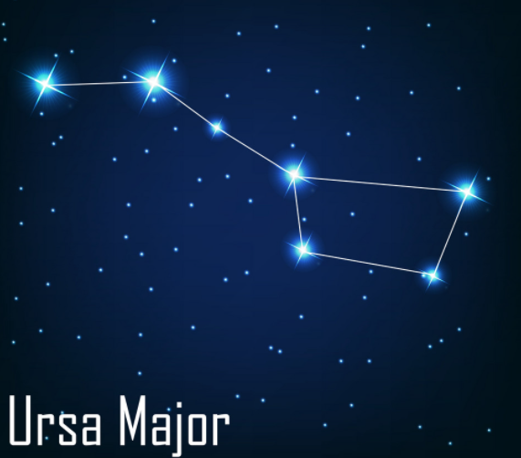
Constellation… .Its is a group of stars that form an image in the sky and in modern astronomy internationally it is defined as the area of celestial sphere. Few constellations are DRACO, GRUS, LEO, URSA, INDUS, HYDRA…
There are 88 total constellations in the world.
Constellation is a group of stars that we can see in a particular area of the night sky.
Some constellation move over the year.
URSA major is one of the famous constellation which can be seen during summer in the early night.
Both ORION and CASSIOPEIA
are visible in winters.

